Slide 1



JDBC
How to connect natively?
Databases
Frameworks
SoftUni Team
Technical Trainers
Software University
http://softuni.bg

Slide 2

Table of Content
JDBC Essentials
Statements
Advanced Concepts

Slide 3
Questions
sli.do #Hibernate

Slide 4

JDBC Essentials

Slide 5
Java Database Connectivity (JDBC)
JDBC is a standard Java API for database-independent connectivity between the Java programming language and a wide range of databases.
The JDBC library includes APIs for each of the tasks mentioned below that are commonly associated with database usage:
Making a connection to a database.
Creating and executing SQL queries in the database.
Viewing & Modifying the resulting records.

Slide 6
JDBC Architecture
APP
JAVA.SQL.*
DRIVER
JDBC
MySQL Oracle PostgreSQL
SQL Server
RDBMS

Slide 7
Driver specifics
JDBC Connection String jdbc:<driver protocol>:<connection details>
JDBC URL
Database | JDBC URL
MySQL | jdbc:mysql://localhost
Oracle | jdbc:oracle:thin:@localhost
SQL Server | jdbc:sqlserver://localhost
PostgreSQL | jdbc:postgresql://localhost

Slide 8

Driver Download
MySQL Connector/J
https://dev.mysql.com/downloads/connector/j/

Slide 9
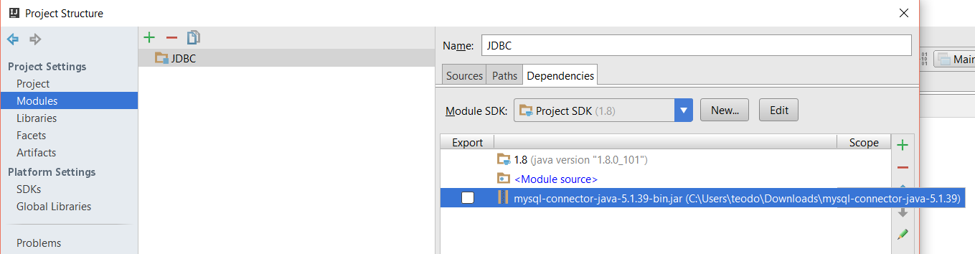
Setup Driver
IntelliJ

Slide 10
Connection Verification
package com.company;
import java.sql.*;
public class Main {
private static final String URL = "jdbc:mysql://localhost:3306/sys";
//Replace with your user name
private static final String USER = "root";
//Replace with your password
private static final String PASSWORD = "1234";
public static void main(String[] args) {
try {
Connection connection = DriverManager.getConnection(URL, USER, PASSWORD);
System.out.println("The connection is successful! Well done bro!");
} catch (SQLException e) {
e.printStackTrace();
}
}
}
JDBC URL
USER
PASS
Connection

Slide 11
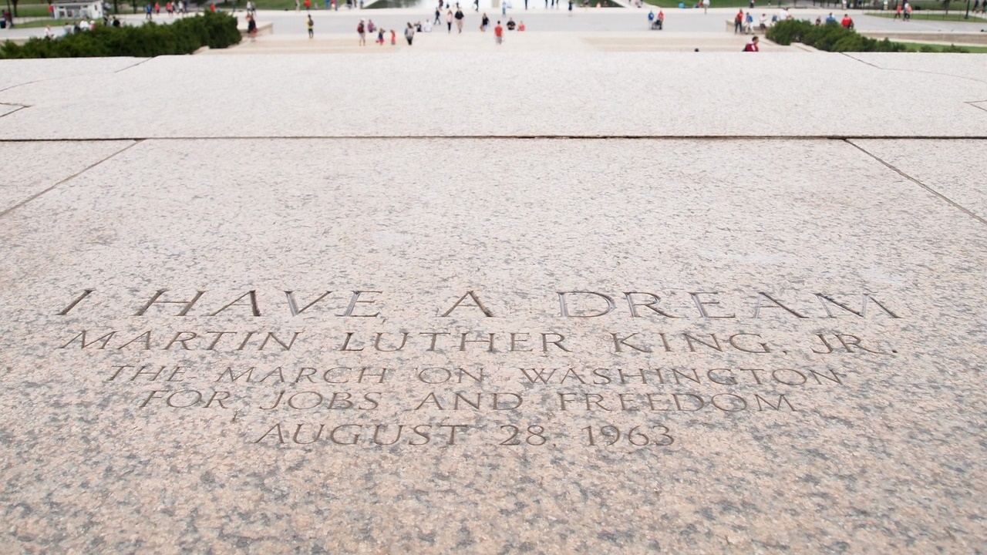
Statements

Slide 12
JDBC Components
The JDBC API provides the following interfaces and classes:
DriverManager – This class manages a list of database drivers.
Driver – This interface handles the communications with the database server.
Connection – The connection object represents communication context.
Statement – Objects used to submit the SQL statements to the database.
ResultSet – These objects hold data retrieved from a database.
SQLException – This class handles any errors that occur in a database application.

Slide 13
Statements
Statement
PreparedStatement
CallableStatement
Interfaces | Recommended Use
Statement | Used the for general-purpose access to the database. The Statement interface cannot accept parameters.
PreparedStatement | Used when SQL statements are used many times. The PreparedStatement interface accepts input parameters at runtime.
CallableStatement | Uses when database stored procedures are called. The CallableStatement interface can also accept runtime input parameters.

Slide 14
JDBC Statement DDL Transactions
public static void main(String[] args) {
try {
Connection connection = DriverManager.getConnection(URL, USER, PASSWORD);
Statement statement = connection.createStatement();
String sql = "CREATE TABLE students(" +
"id INT PRIMARY KEY," +
"name varchar(50)" +
")";
statement.executeUpdate(sql);
} catch (SQLException e) {
e.printStackTrace();
}
}
JDBC URL
Statement
SQL
Execution

Slide 15
JDBC Statement DML Transactions
public static void main(String[] args) {
try {
Connection connection = DriverManager.getConnection(URL, USER, PASSWORD);
Statement statement = connection.createStatement();
String sql = "INSERT INTO students " +
"VALUES(1,'Teo')";
int affectedRows = statement.executeUpdate(sql);
System.out.println(affectedRows);
} catch (SQLException e) {
e.printStackTrace();
}
}
JDBC URL
SQL
Statement
Execution

Slide 16
java.sql.*
DriverManager
Connection
Statement
ResultSet

Slide 17
ResultSet
The SQL statements (SELECT) that read data from a database query, return the data in a result set.
The java.sql.ResultSet interface represents the result set of a database query.
A ResultSet object maintains a cursor that points to the current row in the result set.

Slide 18
JDBC Statement Retrieve Data
JDBC URL
public static void main(String[] args) {
try {
Connection connection = DriverManager.getConnection(URL, USER, PASSWORD);
Statement statement = connection.createStatement();
String sql = "SELECT * FROM students";
ResultSet resultSet = statement.executeQuery(sql);
while(resultSet.next()){
int id = resultSet.getInt("id");
String name = resultSet.getString("name");
System.out.println(String.format("%d, %s",id, name));
}
} catch (SQLException e) {
e.printStackTrace();
}
}
Statement
SQL
Fetch Results
Result Set

Slide 19
JDBC: SQL to Java Translation
SQL data type | Java data type
 | Simply mappable | Object mappable
CHARACTER |  | String
VARCHAR |  | String
LONGVARCHAR |  | String
NUMERIC |  | java.math.BigDecimal
DECIMAL |  | java.math.BigDecimal
BIT | boolean | Boolean
TINYINT | byte | Integer
SMALLINT | short | Integer
INTEGER | int | Integer
BIGINT | long | Long
REAL | float | Float
FLOAT | double | Double
DOUBLE PRECISION | double | Double
BINARY |  | byte[]
VARBINARY |  | byte[]
LONGVARBINARY |  | byte[]
DATE |  | java.sql.Date
TIME |  | java.sql.Time
TIMESTAMP |  | java.sql.Timestamp

Slide 20
JDBC PreparedStatement
public static void main(String[] args) {
try {
Connection connection = DriverManager.getConnection(URL, USER, PASSWORD);
String sql = "SELECT * FROM students WHERE id = ?";
PreparedStatement preparedStatement = connection.prepareStatement(sql);
preparedStatement.setInt(1,1);
ResultSet resultSet = preparedStatement.executeQuery();
}
} catch (SQLException e) {
e.printStackTrace();
}
}
JDBC URL
SQL
Prepared Statement
Result Set

Slide 21
JDBC Parameters
SQL
String sql = "SELECT * FROM students WHERE id = ?";
//…
preparedStatement.setInt(1,1);
Parameter
Parameter Value
Position

Slide 22
JDBC CallableStatement
public static void main(String[] args) {
try {
Connection connection = DriverManager.getConnection(URL, USER, PASSWORD);
String procedure = "CALL usp_update_students (?, ?)";
CallableStatement callableStatement = connection.prepareCall(procedure);
callableStatement.setInt(1, 1);
callableStatement.setString(2, "Teo");
callableStatement.execute();
} catch (SQLException e) {
e.printStackTrace();
}
}
JDBC URL
Procedure
Callable Statement
Add Parameters
Execute

Slide 23

Advanced Concepts

Slide 24
Transactions
public static void main(String[] args) {
try {
Connection connection = DriverManager.getConnection(URL, USER, PASSWORD);
connection.setAutoCommit(false);
Statement statement = connection.createStatement();
String sql = "INSERT INTO students " +
"VALUES(1,'Teo')";
statement.executeUpdate(sql);
connection.commit();
} catch (SQLException e) {
e.printStackTrace();
}
}
JDBC URL
Transaction
Statement
SQL
Execute
Commit

Slide 25
DAO Pattern
interface
StudentDao
+ getAllStudents(): List + updateStudent(): void + deleteStudent(): void + addStudent(): void
Student
id: int name: String
+ Student() + getStudentId(): int + setStudentId(): void + getStudentName(): String + setStudentName(): void
use
implements
StudentDaoImpl
students: List
+ StudentDaoImpl() + getAllStudents(): List + updateStudent(): void + deleteStudent(): void + addStudent(): void

Slide 26

Summary
JDBC Essentials
Statements
Advanced Concepts

Slide 27









JDBC
https://softuni.bg/courses/

Slide 28
SoftUni Diamond Partners

Slide 29
License
This course (slides, examples, demos, videos, homework, etc.) is licensed under the "Creative Commons Attribution-NonCommercial-ShareAlike 4.0 International" license
Attribution: this work may contain portions from
"Databases" course by Telerik Academy under CC-BY-NC-SA license

Slide 30





Free Trainings @ Software University
Software University Foundation – softuni.org
Software University – High-Quality Education, Profession and Job for Software Developers
softuni.bg
Software University @ Facebook
facebook.com/SoftwareUniversity
Software University @ YouTube
youtube.com/SoftwareUniversity
Software University Forums – forum.softuni.bg

